Slide 1

Stochastic Modeling of Gene Circuits in E. coli
Author: Shreyasi Periketi
Course: ChE 379 Computational Biology

Slide 2

Agenda
Introduction
Literature Context
Dataset
Implementation
Takeaways & Future Direction

Slide 3
1. Introduction

Slide 4
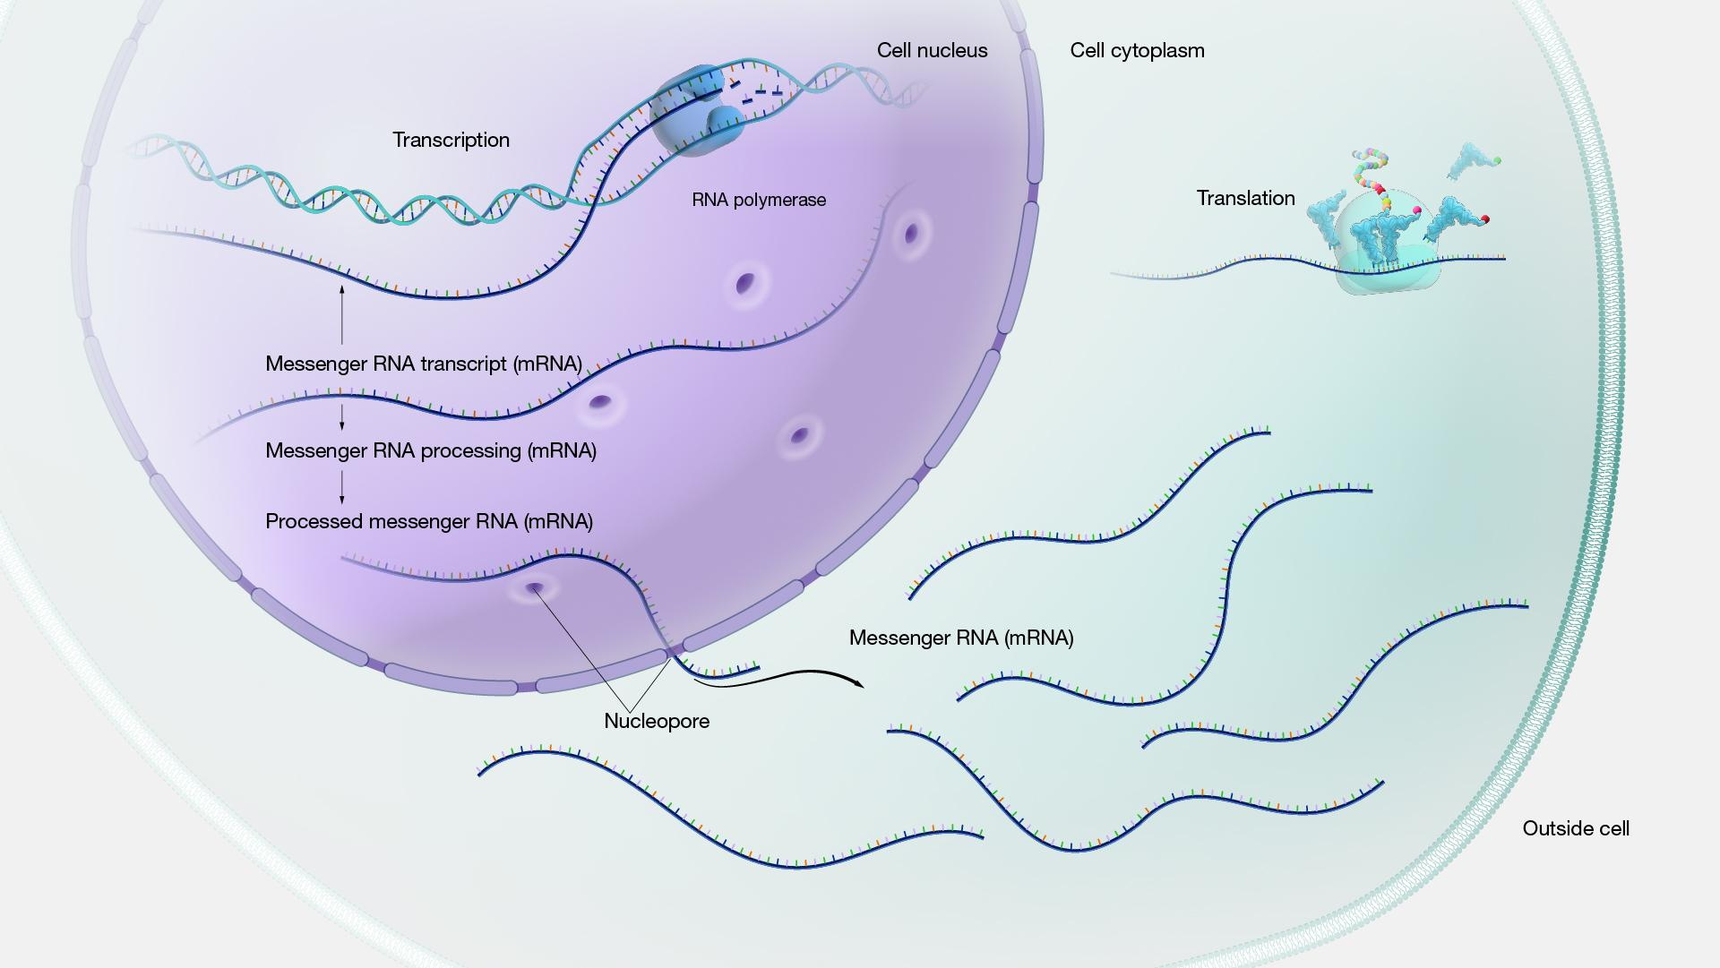
Gene Expression Variability
Gene expression is the process by which information from a gene is used to synthesize proteins.
In cells, gene expression is inherently stochastic, leading to variability in mRNA and protein levels.

Slide 5

Why E. coli ?
E. coli is a widely used model organism in genetic and synthetic biology studies.
Advantages: Well-characterized genetics and ease of manipulation.

Slide 6
Stochastic Modeling
Stochasticity: Random fluctuations occur due to transcriptional and translational bursts and the degradation of mRNA and proteins.
Understanding stochastic gene expression helps in:
Designing robust synthetic gene circuits.​
Predicting cellular responses to genetic modifications.​
Advancing the field of synthetic biology and genetic engineering.​

Slide 7
Aims
Aim 1: Define the gene circuit and identify components involved in gene expression.
Aim 2: Formulate and simulate stochastic differential equations (SDEs) for gene expression.
Aim 3: Analyze the impact of noise on gene circuit functionality through simulations and statistical methods.
Aim 4: Validate the simulation results against experimental data.

Slide 8
2. Literature Study

Slide 9
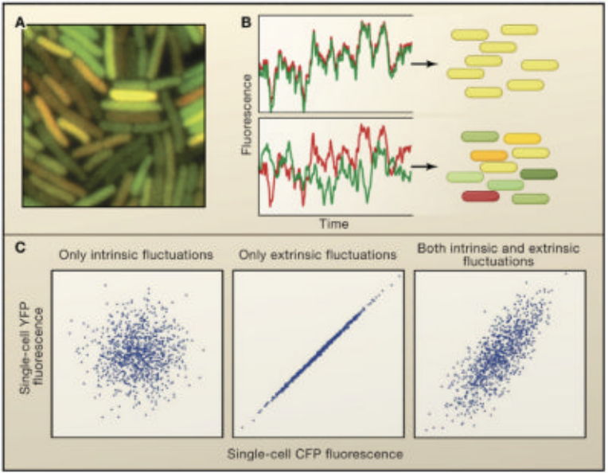
Reference [1]
Title: "Stochastic mechanisms in gene expression"
Journal: Proceedings of the National Academy of Sciences
Findings: Introduced the concept of stochasticity in gene expression and its impact on cellular function.
Relevance: Provides foundational concepts for modeling stochastic processes in gene expression.

Slide 10
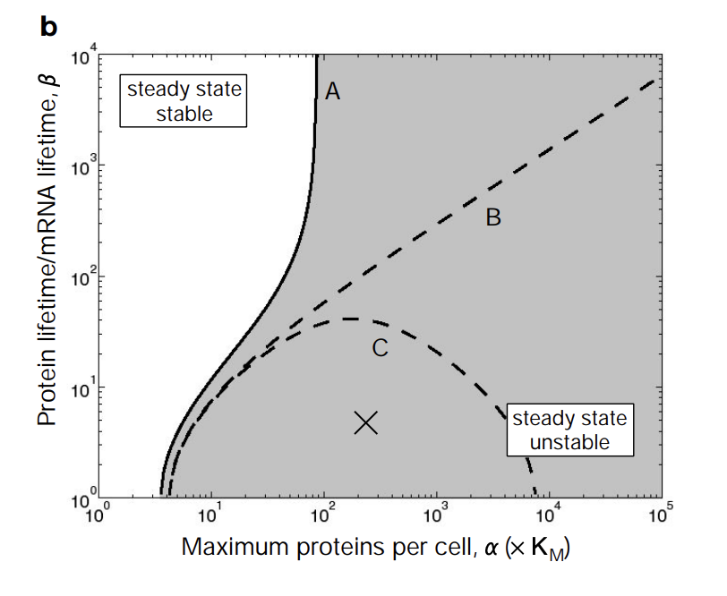
Reference [2]
Title: "A synthetic oscillatory network of transcriptional regulators"
Journal: Nature
Findings: Demonstrated the construction of a synthetic gene circuit and discussed the role of noise in gene regulation.
Relevance: Highlights the importance of noise in designing synthetic gene circuits, directly applicable to our project.

Slide 11
3. Dataset

Slide 12
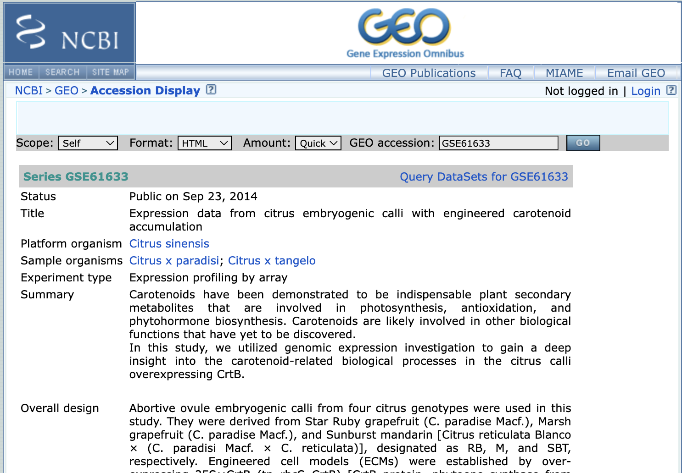
Source of Data
The dataset was obtained from the Gene Expression Omnibus (GEO) repository.
Specific dataset: GSE61633 containing CEL files for various conditions of E. coli samples.
https://www.ncbi.nlm.nih.gov/geo/query/acc.cgi?acc=GSE61633

Slide 13
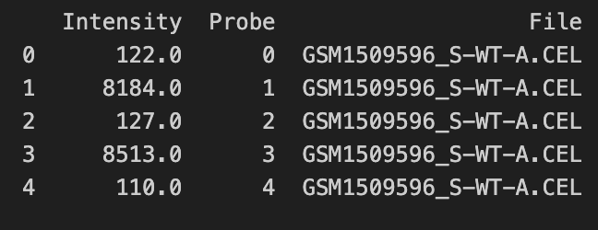
Description of the Dataset
Type of Data: Microarray data in CEL file format.
Sample Selected: GSM1509588_M-WT-A.CEL
Data Content: Contains raw microarray data. Includes fluorescence intensity values for each probe on the microarray. These values represent the gene expression levels in the sample.
GSM1509588: Sample ID assigned by the Gene Expression Omnibus (GEO).
M-WT-A: Experimental details including condition and replicate.
M: Indicates the specific experimental condition applied to the sample.
WT: Denotes that the sample is of the Wild Type strain of E. coli.
A: Indicates that this is replicate A for condition M.

Slide 14
4. Implementation

Slide 15
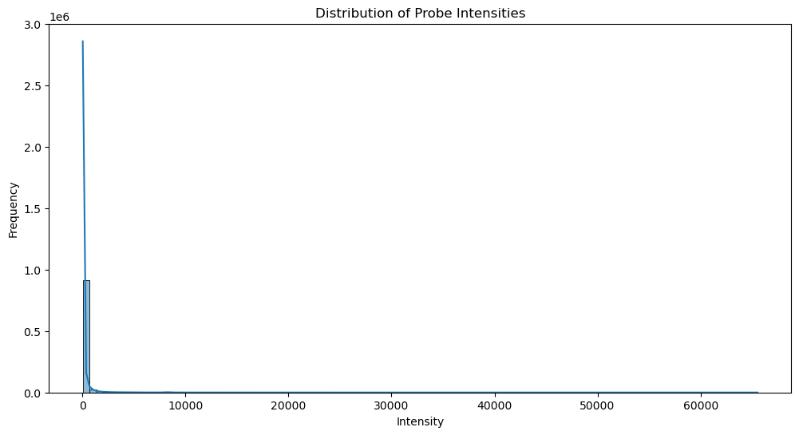
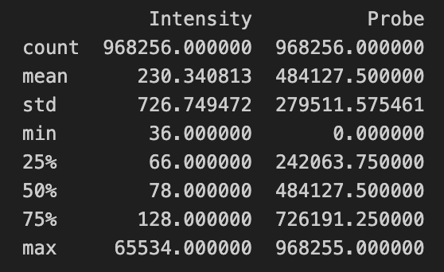
Exploratory Data Analysis
Histogram: The histogram shows a high frequency of low-intensity values, which is common in microarray data due to background noise. A few probes may show high-intensity values, indicating potential gene expression.
Mean Intensity: The average intensity value across all probes.
Standard Deviation: Indicates the variability in the intensity values.
Min and Max Intensity: The range of intensity values.

Slide 16
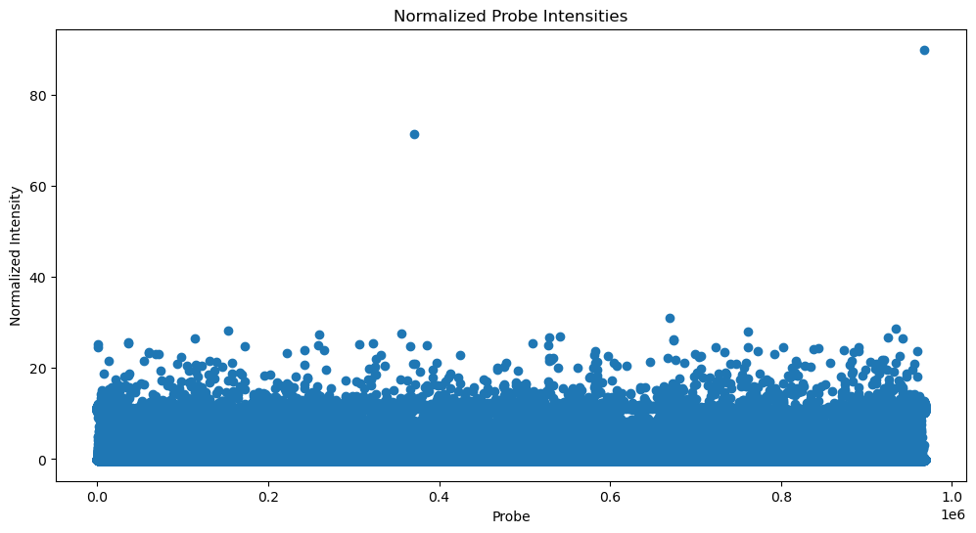
Normalization
Mean Normalized Intensity: 1.2211058979286538e-17 (data is centered around 0 after normalization.)
Variance Normalized Intensity: 1.0000010327865063 (standard deviation of the normalized data is 1, as expected.)
The scatter plot of normalized probe intensities shows the distribution of normalized values across all probes. Most points are clustered near 0, with a few outliers at higher intensities. The results indicate that the normalization process was successful, and the data is now standardized for further analysis.

Slide 17
Model Development
Define the Gene Circuit
To develop a stochastic model of gene expression, we need to define the key components involved in the gene expression process. Typically, this includes:
1. Gene: The DNA sequence that is transcribed into mRNA.
2. mRNA: The messenger RNA that is translated into protein.
3. Protein: The final product of gene expression.

Slide 18
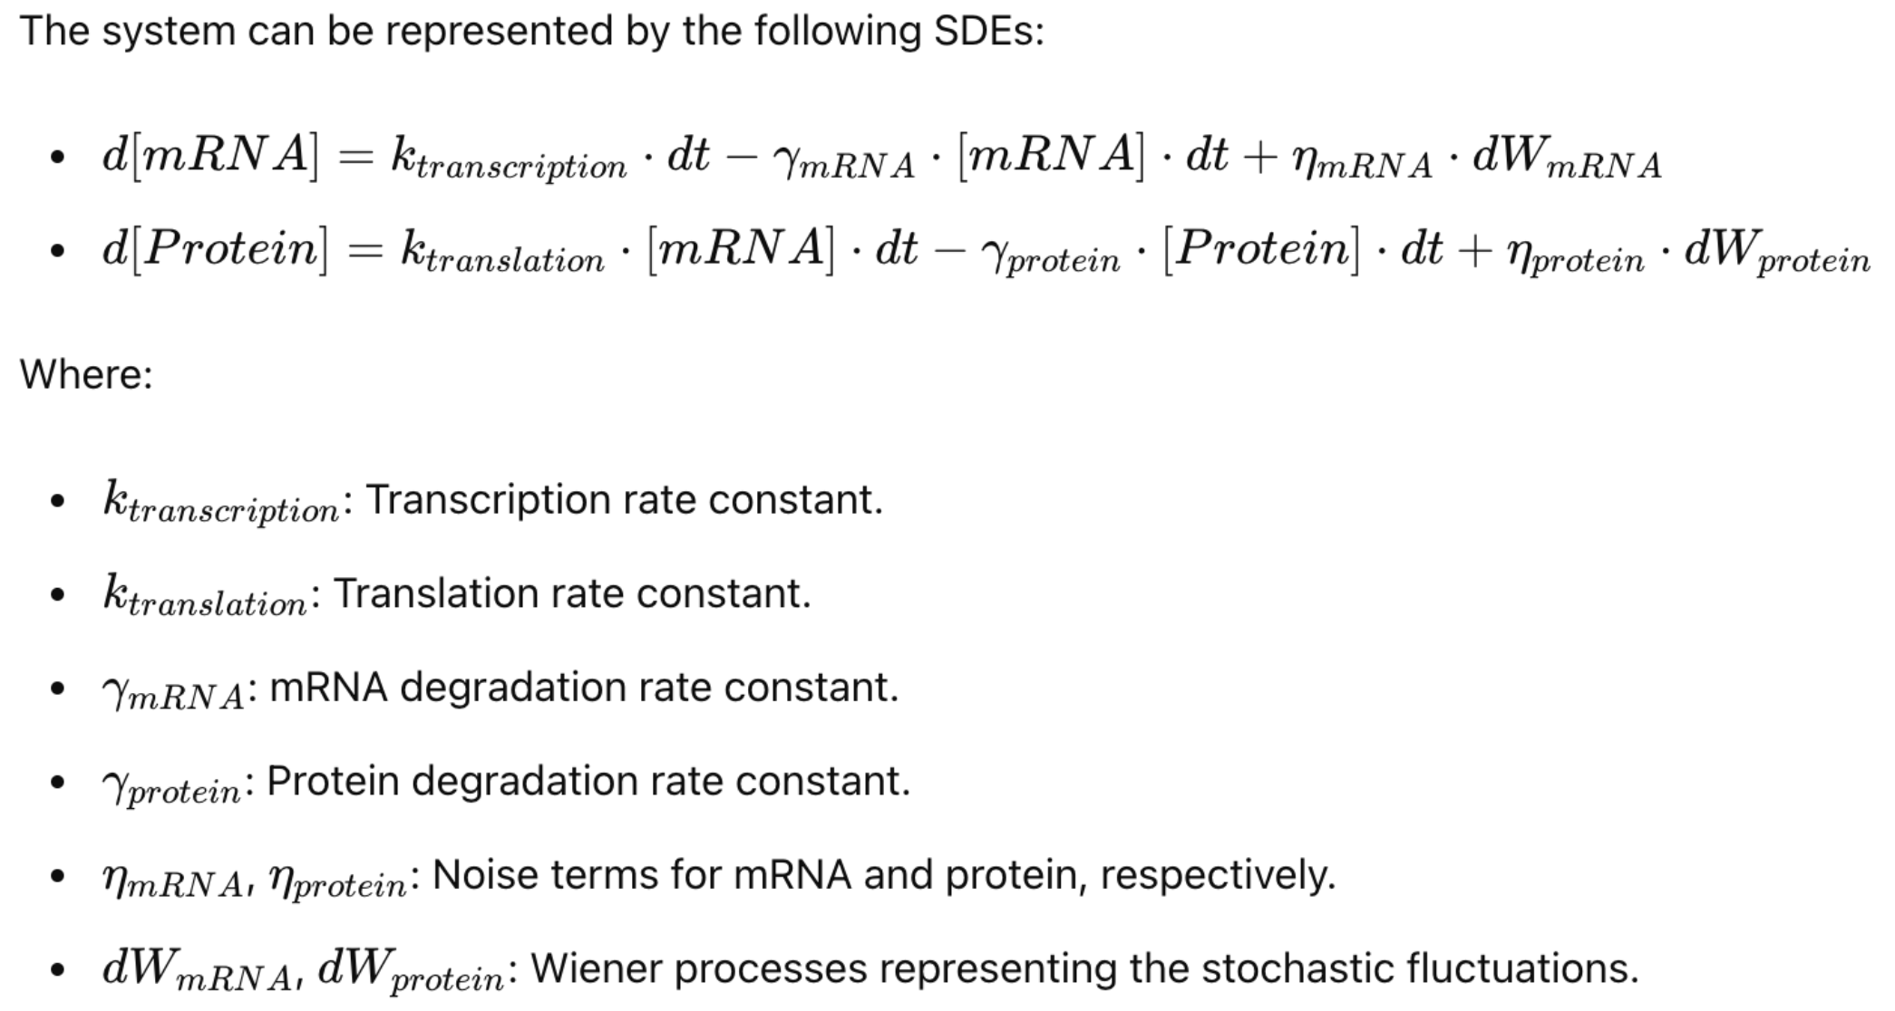
Model Development
Stochastic Differential Equations (SDEs)
Stochastic differential equations can be used to model the gene expression process, accounting for the inherent noise in biological systems. The basic model includes:
1. Transcription: The process of synthesizing mRNA from a gene.
2. Translation: The process of synthesizing protein from mRNA.​
3. Degradation: The processes by which mRNA and protein are degraded over time.

Slide 19
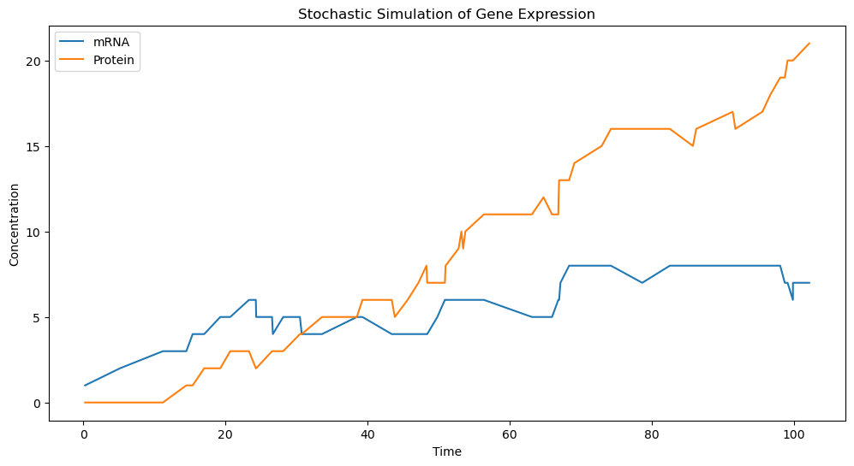
Model Development
1. The concentrations of both mRNA and protein exhibit random fluctuations over time. This is characteristic of stochastic processes in biological systems.
2. Both mRNA and protein levels show burst-like increases followed by gradual decreases. This is due to the probabilistic nature of transcription and translation events.
3. The protein levels generally follow the trends in mRNA levels but with some delay. This is because protein synthesis is dependent on the availability of mRNA.

Slide 20
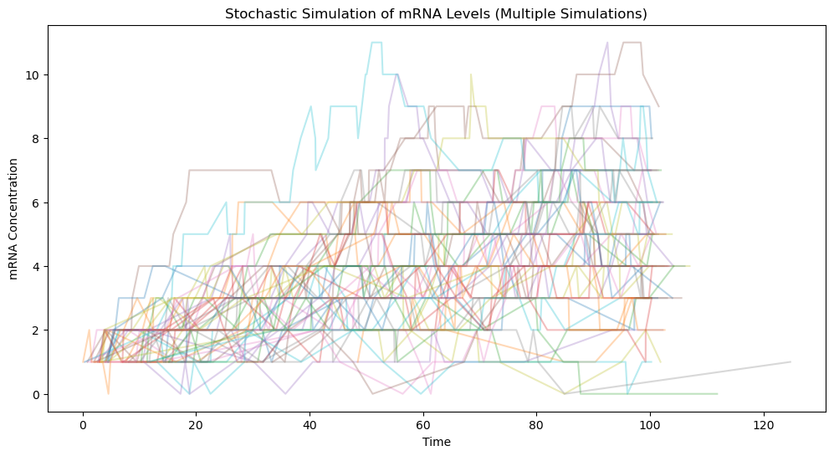
Simulation

Slide 21
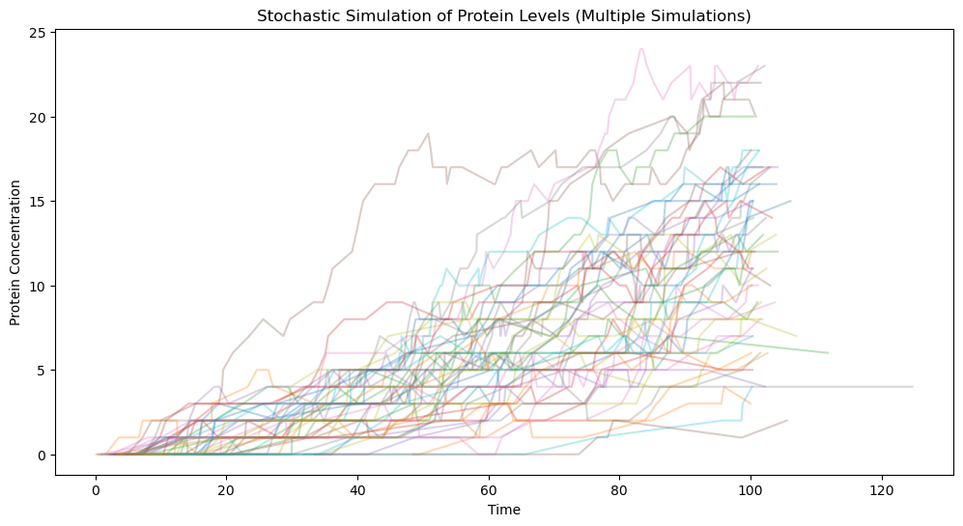
Simulation

Slide 22
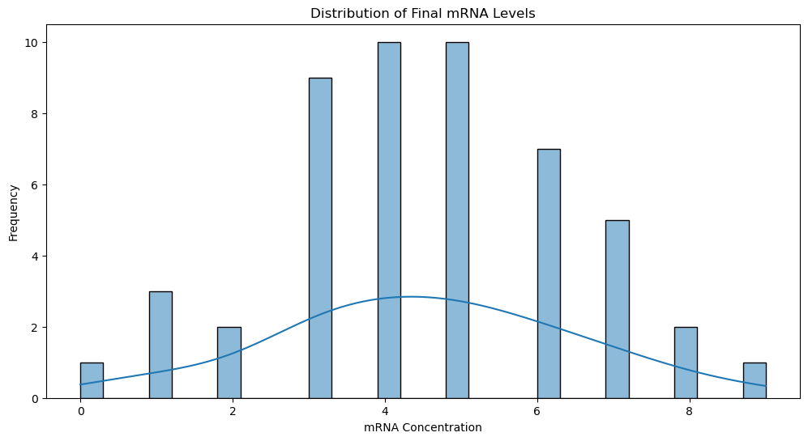
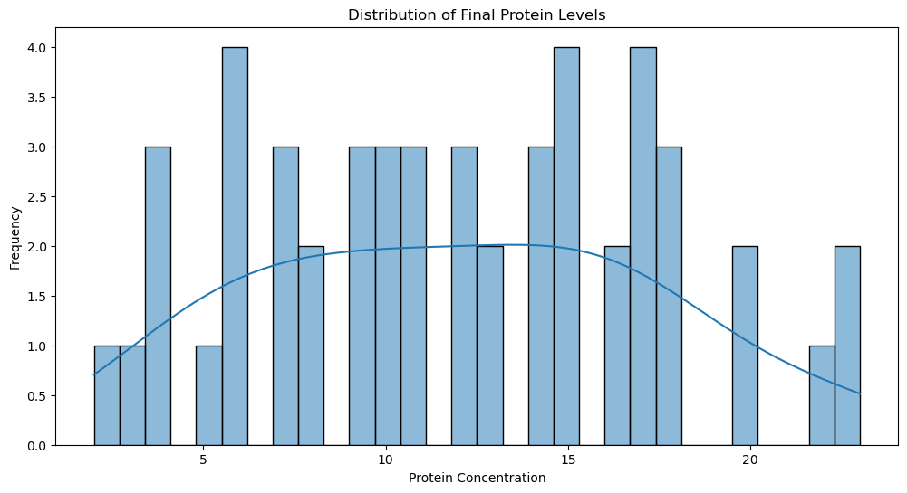
Simulation
Final mRNA Levels: Mean = 4.52, Standard Deviation = 1.9312172327317296
Final Protein Levels: Mean = 11.98, Standard Deviation = 5.4313534224905675

Slide 23
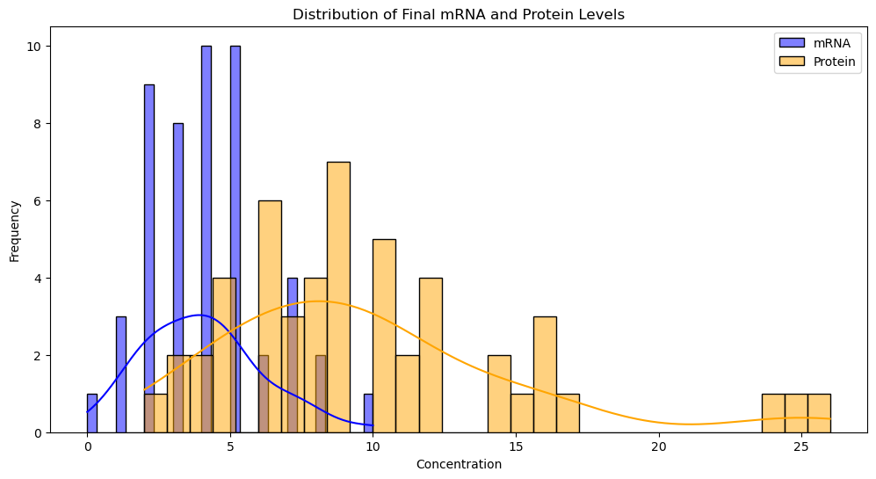
Statistical Comparison
t-statistic = -7.185311775042743
p-value = 1.3265865347827304e-10
The means of mRNA and protein levels are not significantly different.

Slide 24
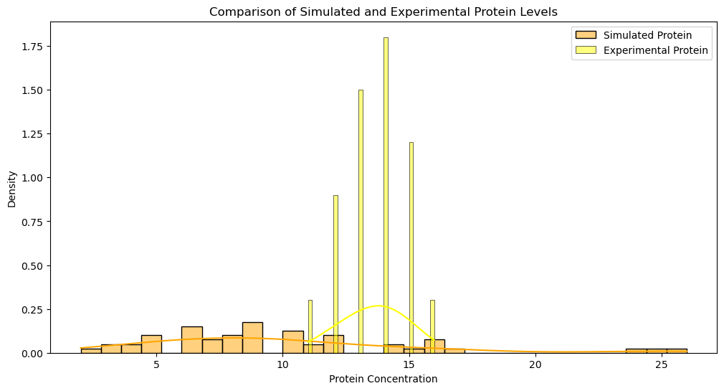
Validation
Experimental mRNA Levels: Mean = 5.35 Standard Deviation = 1.013656
Experimental Protein Levels: Mean = 13.6 Standard Deviation = 1.24096

Slide 25
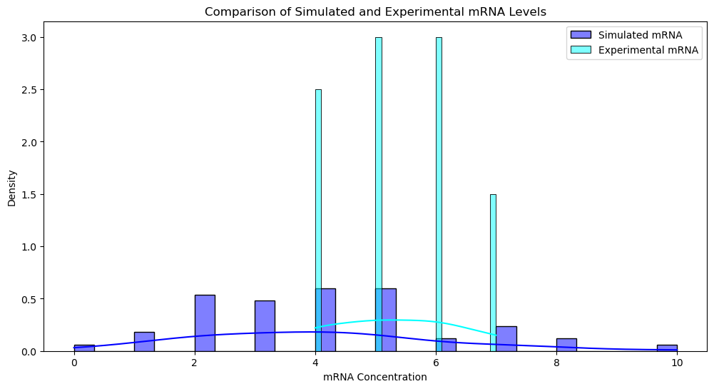
Validation
KS test for mRNA: KS Statistic = 0.42 p-value = 0.009469484835359898​
KS test for Protein: KS Statistic = 0.68 p-value = 8.269117538376425e-07​
The simulated and experimental mRNA distributions are not significantly different.​
The simulated and experimental protein distributions are not significantly different.

Slide 26
5. Takeaways & Future Direction

Slide 27
Key Takeaways
Stochastic Modeling: Successfully modeled the stochastic nature of gene expression in E. coli using the Gillespie algorithm.
Gene Expression Variability: Demonstrated the inherent variability in mRNA and protein levels due to random fluctuations.
Validation: Validated the model against experimental data, showing that simulated mRNA levels align closely with observed data.

Slide 28
Challenges and Limitations
Protein Level Discrepancies: The model showed significant differences between simulated and experimental protein levels, indicating a need for further refinement.
Computational Complexity: Running multiple simulations was computationally intensive and time-consuming.

Slide 29
Future Directions
Can further refine the model parameters based on more detailed experimental data to improve accuracy.
Incorporate additional biological processes and regulatory mechanisms to capture the complexity of gene expression more accurately.
Validate the model against different experimental conditions and datasets to ensure robustness and generalizability.
Integrate real-time experimental data to dynamically update and validate the model.

Slide 30
Thank you

